Slide 1
AWS identity and access management
Dr. Noman Islam

Slide 2
Introduction
IAM is a powerful service that allows you to control how people and programs are allowed to manipulate your AWS infrastructure.
IAM uses traditional identity concepts such as users, groups, and access control policies to control who can use your AWS account, what services and resources they can use, and how they can use them.
The control provided by IAM is granular enough to limit a single user to the ability to perform a single action on a specific resource from a specific IP address during a specific time window.

Slide 3
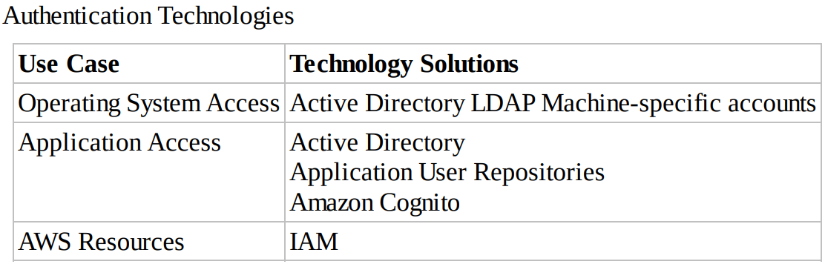

Slide 4
Principals
The first IAM concept to understand is principals.
A principal is an IAM entity that is allowed to interact with AWS resources.
A principal can be permanent or temporary, and it can represent a human or an application.
There are three types of principals: root users, IAM users, and roles/temporary security tokens.

Slide 5
Root User
When you first create an AWS account, you begin with only a single sign-in principal that has complete access to all AWS Cloud services and resources in the account.
This principal is called the root user.
As long as you have an open account with AWS, the root user for that relationship will persist. The root user can be used for both console and programmatic access to AWS resources.

Slide 6
It is strongly recommended that you do not use the root user for your everyday tasks, even the administrative ones.
Instead, adhere to the best practice of using the root user only to create your first IAM user and then securely locking away the root user credentials.

Slide 7
IAM Users
Users are persistent identities set up through the IAM service to represent individual people or applications.
You may create separate IAM users for each member of your operations team so they can interact with the console and use the CLI.
You might also create dev, test, and production users for applications that need to access AWS Cloud services

Slide 8
IAM users can be created by principals with IAM administrative privileges at any time through the AWS Management Console, CLI, or SDKs.
Users are persistent in that there is no expiration period; they are permanent entities that exist until an IAM administrator takes an action to delete them.

Slide 9
Roles/Temporary Security Tokens
Roles are used to grant specific privileges to specific actors for a set duration of time.
These actors can be authenticated by AWS or some trusted external system.
When one of these actors assumes a role, AWS provides the actor with a temporary security token from the AWS Security Token Service (STS) that the actor can use to access AWS Cloud services.
Requesting a temporary security token requires specifying how long the token will exist before it expires

Slide 10
Roles and temporary security tokens enable a number of use cases:
Amazon EC2 Roles—Granting permissions to applications running on an Amazon EC2 instance.
Cross-Account Access—Granting permissions to users from other AWS accounts, whether you control those accounts or not.
Federation—Granting permissions to users authenticated by a trusted external system.

Slide 11
Amazon EC2 Roles
Suppose that an application running on an Amazon EC2 instance needs to access an Amazon Simple Storage Service (Amazon S3) bucket
Create an IAM role that grants the required access to the Amazon S3 bucket.
When the Amazon EC2 instance is launched, the role is assigned to the instance.
When the application running on the instance uses the Application Programming Interface (API) to access the Amazon S3 bucket, it assumes the role assigned to the instance and obtains a temporary token that it sends to the API.

Slide 12
The process of obtaining the temporary token and passing it to the API is handled automatically by most of the AWS SDKs, allowing the application to make a call to access the Amazon S3 bucket without worrying about authentication.

Slide 13
Cross-Account Access
Another common use case for IAM roles is to grant access to AWS resources to IAM users in other AWS accounts.
These accounts may be other AWS accounts controlled by your company or outside agents like customers or suppliers.
You can set up an IAM role with the permissions you want to grant to users in the other account, then users in the other account can assume that role to access your resources.
This is highly recommended as a best practice, as opposed to distributing access keys outside your organization.

Slide 14
Federation
Many organizations already have an identity repository outside of AWS and would rather leverage that repository than create a new and largely duplicate repository of IAM users.
Similarly, web-based applications may want to leverage web-based identities such as Facebook, Google, or Login with Amazon.
IAM Identity Providers provide the ability to federate these outside identities with IAM and assign privileges to those users authenticated outside of IAM.

Slide 15
Authentication
There are three ways that IAM authenticates a principal
User Name/Password—When a principal represents a human interacting with the console, the human will provide a user name/password pair to verify their identity. IAM allows you to create a password policy enforcing password complexity and expiration.

Slide 16
Access Key—An access key is a combination of an access key ID (20 characters) and an access secret key (40 characters). When a program is manipulating the AWS infrastructure via the API, it will use these values to sign the underlying REST calls to the services. The AWS SDKs and tools handle all the intricacies of signing the REST calls, so using an access key will almost always be a matter of providing the values to the SDK or tool.
Access Key/Session Token—When a process operates under an assumed role, the temporary security token provides an access key for authentication. In addition to the access key (remember that it consists of two parts), the token also includes a session token. Calls to AWS must include both the two-part access key and the session token to authenticate.

Slide 17
Authorization
After IAM has authenticated a principal, it must then manage the access of that principal to protect your AWS infrastructure.
The process of specifying exactly what actions a principal can and cannot perform is called authorization.

Slide 18
Policies
A policy is a JSON document that fully defines a set of permissions to access and manipulate AWS resources. Policy documents contain one or more permissions, with each permission defining:
Effect—A single word: Allow or Deny.
Service—For what service does this permission apply? Most AWS Cloud services support granting access through IAM, including IAM itself.
Resource—The resource value specifies the specific AWS infrastructure for which this permission applies. This is specified as an Amazon Resource Name (ARN)

Slide 19
Action—The action value specifies the subset of actions within a service that the permission allows or denies. For instance, a permission may grant access to any read-based action for Amazon S3. A set of actions can be specified with an enumerated list or by using wildcards (Read*)
Condition—The condition value optionally defines one or more additional restrictions that limit the actions allowed by the permission

Slide 20
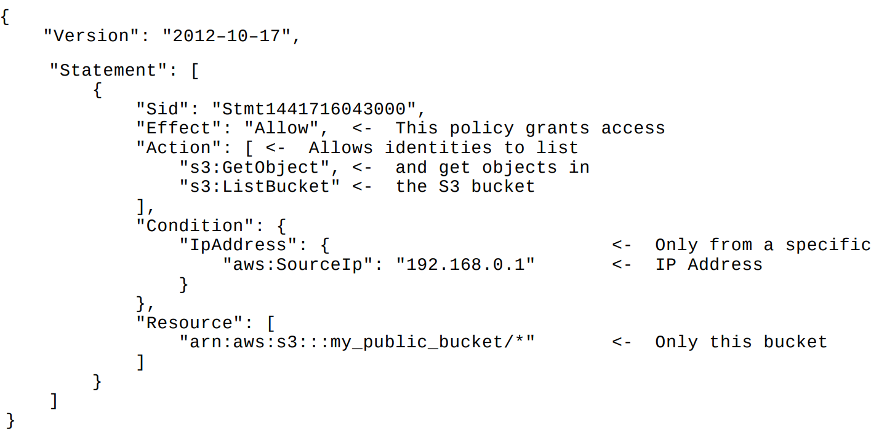

Slide 21
Associating Policies with Principals
A policy can be associated directly with an IAM user in one of two ways:
User Policy—These policies exist only in the context of the user to which they are attached. In the console, a user policy is entered into the user interface on the IAM user page.
Managed Policies—These policies are created in the Policies tab on the IAM page (or through the CLI, and so forth) and exist independently of any individual user. In this way, the same policy can be associated with many users or groups of users.

Slide 22
There are two ways a policy can be associated with an IAM group:
Group Policy—These policies exist only in the context of the group to which they are attached. In the AWS Management Console, a group policy is entered into the user interface on the IAM Group page.
Managed Policies—In the same way that managed policies (discussed in the “Authorization” section) can be associated with IAM users, they can also be associated with IAM groups

Slide 23
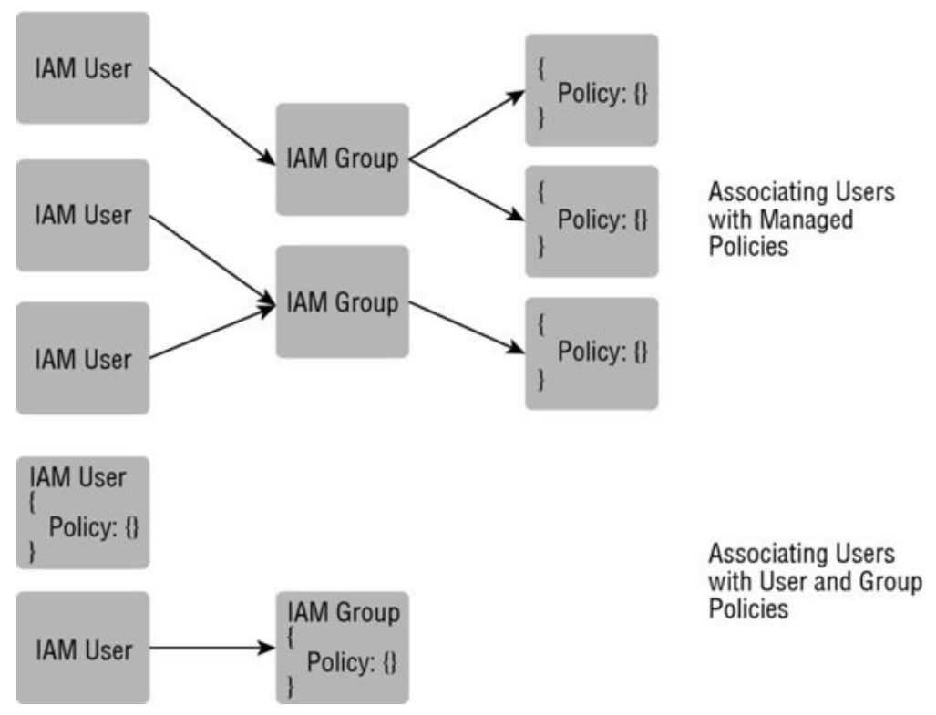

Slide 24
The final way an actor can be associated with a policy is by assuming a role. In this case, the actor can be:
An authenticated IAM user (person or process). In this case, the IAM user must have the rights to assume the role.
A person or process authenticated by a trusted service outside of AWS, such as an on-premises LDAP directory or a web authentication service. In this situation, an AWS Cloud service will assume the role on the actor’s behalf and return a token to the actor.

Slide 25
Other key features
Beyond the critical concepts of principals, authentication, and authorization, there are several other features of the IAM service that are important to understand to realize the full benefits of IAM.

Slide 26
Multi-Factor Authentication (MFA)
Multi-Factor Authentication (MFA) can add an extra layer of security to your infrastructure by adding a second method of authentication beyond just a password or access key.
With MFA, authentication also requires entering a One-Time Password (OTP) from a small device.

Slide 27
Rotating Keys
The security risk of any credential increases with the age of the credential. To this end, it is a security best practice to rotate access keys associated with your IAM users.
IAM facilitates this process by allowing two active access keys at a time.

Slide 28
Resolving Multiple Permissions
Occasionally, multiple permissions will be applicable when determining whether a principal has the privilege to perform some action
Initially the request is denied by default.
All the appropriate policies are evaluated; if there is an explicit “deny” found in any policy, the request is denied and evaluation stops.
If no explicit “deny” is found and an explicit “allow” is found in any policy, the request is allowed.
If there are no explicit “allow” or “deny” permissions found, then the default “deny” is maintained and the request is denied.

Slide 29
Summary
IAM is a powerful service that gives you the ability to control which people and applications can access your AWS account at a very granular level
Because the root user in an AWS account cannot be limited, you should set up IAM users and temporary security tokens for your people and processes to interact with AWS.
Policies define what actions can and cannot be taken.
Policies are associated with IAM users either directly or through group membership
IAM user accounts can be further secured by rotating keys, implementing MFA, and adding conditions to policies.

